Slide 1

K-means clustering method based network shared resources mining
A Short story Presented by
kancheti sai pragna
Sjsu_id: 016698552

Slide 2

Why mining network shared resources?
The demand for data resource sharing in internet has been growing and this brought up many optimization techniques in utilizing efficiency of resources.
At present, there are at least 15 Trillion files available on the internet, The vast availability of resources makes a complex task in retrieving the relevant data resources efficiently
In order to solve problems of large redundant information and relevant data resources research the need for data mining in network shared data resources arose.

Slide 3
Existing Methods of network shared resources mining
There has been a significant research done in data mining methods in relevant data resources research and various techniques came into picture.
clustering analysis algorithm based Method where it uses clustering analysis algorithm to process resource data, construct the data preprocessing set, and calculate the data feature vector.
Another method based on multi-dimensional resource coordination and aggregation where this technique focuses on using the data center's network resource sharing process analysis as the basis for building a multidimensional resource aggregation data model.
using fuzzy logic to build multidimensional collaborative fitness functions, and using data mining to optimize decision-making in order to increase the execution efficiency of the data mining process.
However, Although these methods produced some excellent results they lack in run time efficiency, precision and they are usually complex to apply practically.
In order to overcome above drawbacks a new method based on k means clustering algorithm has come into picture.

Slide 4
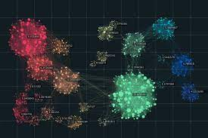
Clustering

Slide 5
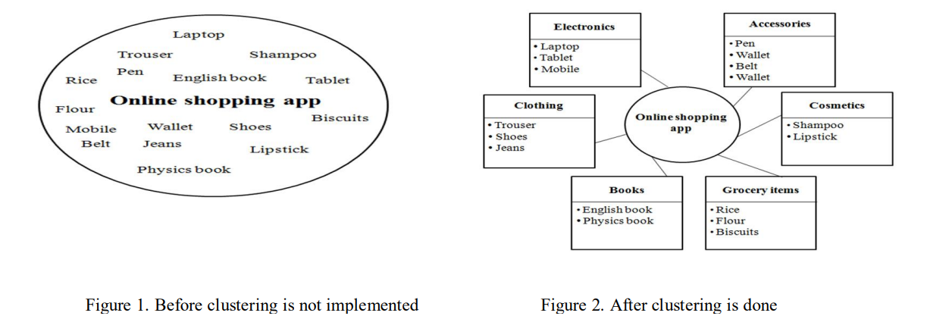
What is Clustering?
Clustering is used in assembling bulky data into clusters or groups that helps us to visualize the internal structure of the data. Basically, it is a grouping of items based on how similar and distinct they are to one another
For example, there is some online shopping site where we can find variety of stuffs from electronics, clothing, books, grocery items, cosmetic items, accessories. Here in figure 2 describes how it looks after clustering is done.

Slide 6
Stages of clustering
Raw Data
Clustering Algorithm
Clusters

Slide 7
Stages of clustering
Raw Data: Raw data (which are not being processed yet) are collected from various sources on which we want to solicit various clustering algorithm
Clustering Algorithm: A specific algorithm is selected according to our requirements and then that very algorithm is applied on the raw data that were being selected.
Clusters: After soliciting the selected clustering algorithm on the raw data, we acquire our clusters.

Slide 8
Types of clustering
Partitioning Method
Density-based Method
Hierarchical Method
Grid-based method
Model-based clustering method
Constraint-based method

Slide 9
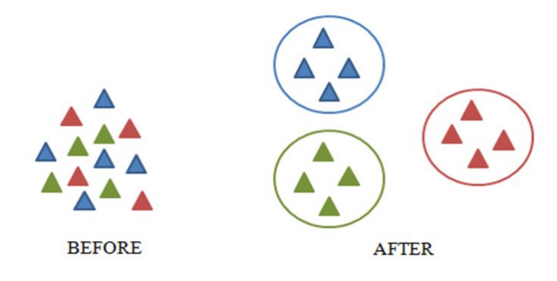
Partitioning Method
In the case of partitioning clustering method, the objects of the datasets are segregated into numerous subsets.
Given some examples of the partitioning algorithms are K-means, PAM (Partitioning AroundMedoids).
The figure shows how clusters are formed after applying partitioning clustering technique

Slide 10

Density-based Method
Density-Based Clustering method identify distinctive clusters in the data, based on the idea that a cluster/group in a data space is a contiguous region of high point density, separated from other clusters by sparse regions.
Basically, in this method clusters are formed or the data spaces are partitioned by the density of the data point in a particular region
The figure shows how clusters are formed after applying Density-Based Method of clustering

Slide 11
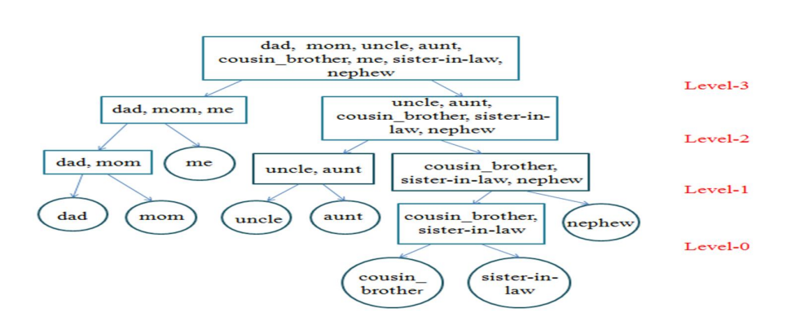
Hierarchical Method
In the case of hierarchical clustering method, the objects of the datasets are segregated in the hierarchical fashion of clusters or groups.
Examples: Agglomerative Hierarchical clustering algorithm (AGNES), Divisive Hierarchical clustering algorithm (DIANA) etc.,
The figure shows how clusters are formed after applying Hierarchical Method of clustering

Slide 12
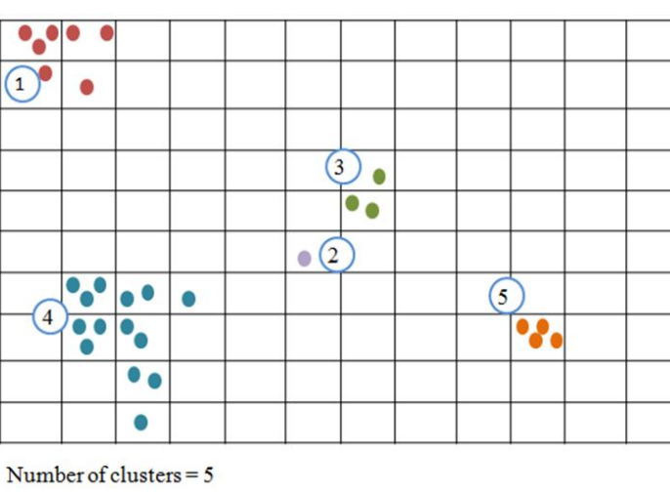
Grid-based method
In grid-based clustering method, the object space is divided into fixed number of cells that forms the shape of a grid like structure. Clustering algorithm is STING (Statistical Information Grid).
The figure shows how clusters are formed after applying grid-based clustering methodrid-based method

Slide 13
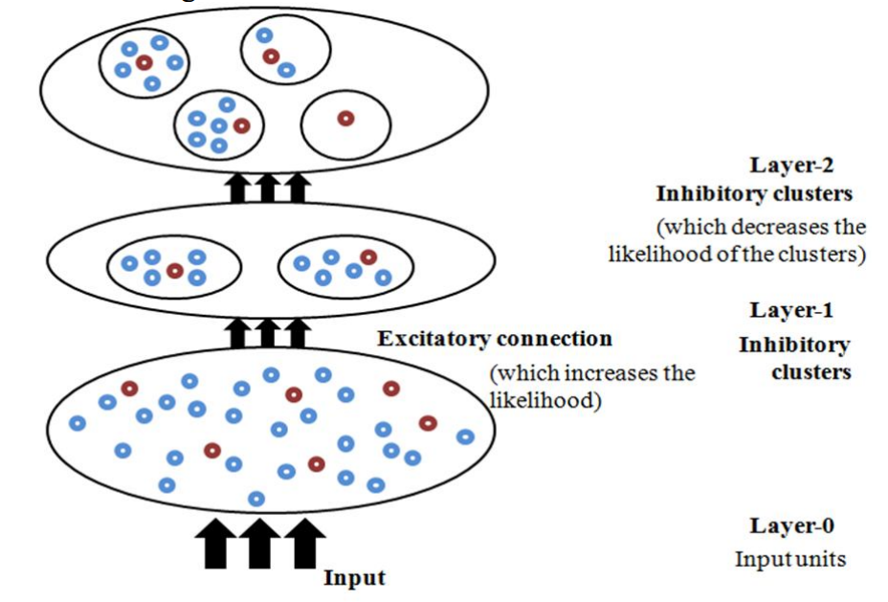
Model-based clustering method
Model-based clustering works on the concept of Probability Model which is a mathematical representation of any random occurrence of dataset. Each of the groups that would form will have different Probability Model.
The figure shows how clusters are formed after applying Model-based clustering method

Slide 14
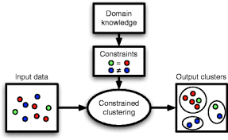
Constraint-based method
Constrained-based clustering method is a semi-supervised learning technique where amalgamation of small proportion of labeled data with a large proportion of unlabeled data occurs.
Constrained K-means (COP-K-Means) algorithm is one of the common algorithms using this method
The figure illustrates clustering using Constraint-based method.

Slide 15

K-means clustering

Slide 16
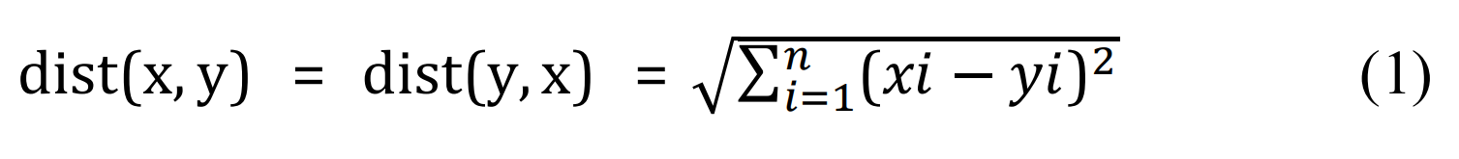
K-means clustering algorithm
The K-Means algorithm is a sort of partition-based clustering approach that belongs to the unsupervised learning techniques. It divides a huge set of data into K number of smaller groups. The two distinct steps of this method are described below.
a. First phase: K centroids or centers are selected haphazardly in this phase. K should have a permanent value. During the procedure, it cannot be changed.
b. Second phase: Each data point is given its closest center or centroids during this phase. Euclidean distance is used to calculate the separation between cluster centroids or centers and all data points.
The distance between any two points, let's say point x and point y, is known as the Euclidean distance. The separation between x and y is equal to the separation between x and y. Equation (1) states the following for the Euclidean distance between any two randomly chosen points, x and y:

Slide 17
K-means clustering algorithm
Algorithm for K-Means
1. Input: Choose a database and select the value of K that is the number of clusters we want at the end.Let
the database be D with n number of data objects. D = {d1, d2, d3, ….,dn}
2. Output: We will obtain an arrangement of K number of clusters.
3. Algorithm
(i) Randomly select the number of clusters, K.
(ii) Choose the centre or the centroids for K clusters. The initial values of the centres are selected
arbitrarily.

Slide 18
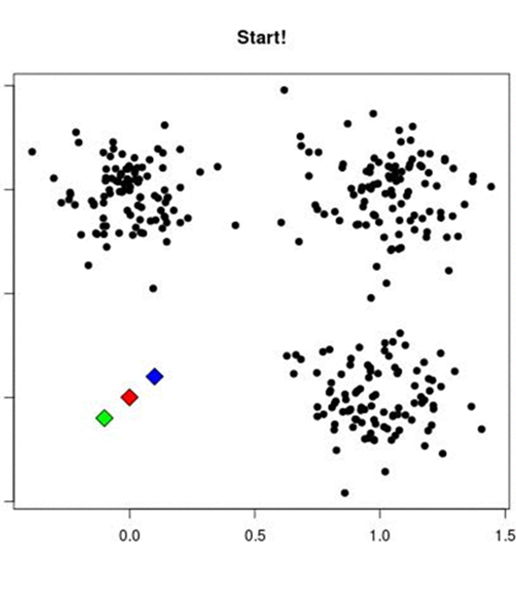
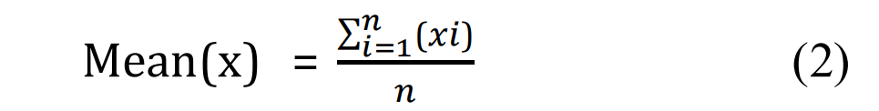
K-means clustering algorithm
(iii) Arrange all data objects to the closest cluster; this is determined with the help of Euclidean distance
theory.
(iv) Again calculate the centre of the cluster. This is evaluated by taking the mean of the data objects
present in each of the cluster individually. If there are n objects say x1, x2, x3, …., and then the mean is
given in equation (2)
(v) Repeat step (iii) and (iv) until convergence. This is basically an iterative technique

Slide 19

Application of k-means clustering algorithm in mining of network shared resources

Slide 20
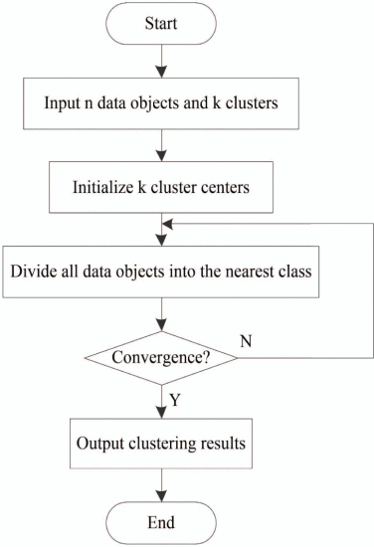
K-means-based data clustering of network shared resources
The K-means algorithm has emerged as the most well-known and widely used algorithm in the process of data collecting due to its advantages of high data processing efficiency, low computational complexity, and strong scalability.
The data of Network shared resources is clustered in to different classes using k-means clustering in the manner shown in the image.

Slide 21
K-means-based data clustering of network shared resources
When compared to existing methods that are mentioned above the K-means clustering algorithm has the following advantages:
The K-means clustering technique has a significant robustness when managing data sets. In particular, when using the algorithm to handle the class and the class has a large gap between the data set, the classification results are improved.
The input order of data objects has almost no impact on the classification outcomes when numerical data sets are classified using the K-means clustering algorithm.

Slide 22
K-means-based data clustering of network shared resources
The reason is that in order to achieve the classification of the data set, the distance formula is applied to determine the distance from each data object to the center point during the clustering process using this technique.
Which was not in the case of above mentioned methods where the outcomes of classification division are hugely impacted buy the order of input objects.
This algorithm is capable of handling big data sets. The outcomes of data clustering won't be affected if there is data overlap between different data sets, hence this approach has good practical use.

Slide 23

Comparisons with existing methods

Slide 24
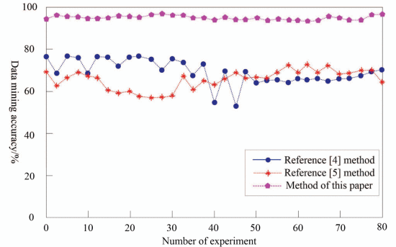
Accuracy comparison
The accuracy of k-means based method is almost close to 97% while the other methods could not be more than 80% as the number of experiments increases.

Slide 25
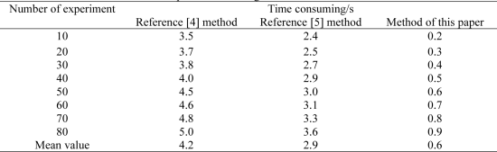
Data mining time comparison
The average time for data mining using K-means clustering based method is only 0.6s. whereas, the average time for other methods are almost 4.2 and 2.9 seconds.

Slide 26
conclusion
in order to improve the quality of network shared resource data mining, the K-means cluster network data mining technique has accuracy of in-depth data mining of network shared resources by the method is always over 94%, and the average time of in-depth data mining is only 0.6s,.
suggesting that this method can achieve fast and accurate in-depth data mining of network shared resources.
Yet, there are still a number of challenges including the deep mining of language and cross-cultural resource sharing as well as the security, personalization, and intelligence of resource data mining to resolve.

Slide 27
Thank you

